Slide 1
Rappi Experimentation & Analitics Senior Case

Slide 2
Whoa!
Juan Carranza
jdcarranzas@outlook.com

Slide 3
Table of contents
Bussiness Case
EDA
01
02
Prior Analysis
Experiment
03
04
What are we looking for?
What we learned from the data
Possible patterns in the data
How we set the environment
Modelling
Recomendations
05
06
Techniques and results
Final conclusions and remarks

Slide 4
01
Bussiness Case
What are we looking for?

Slide 5
Introduction
Rappi’s Operations team is interested in decreasing the number of orders that are not taken by any courier, due to the fact that they are not attractive enough for couriers.

Slide 6



Scope
Medition
Variables
Objective
Date time data, measured in one month. September 2017.
Distance from user to store (km), difference in meters between the store and user altitude, total earning, taken as a binary variable: 1 if taken, 0 otherwise.
Identify key drivers that might predict if a given order is taken or not.

Slide 7

EDA
02
What we learned from the data

Slide 8
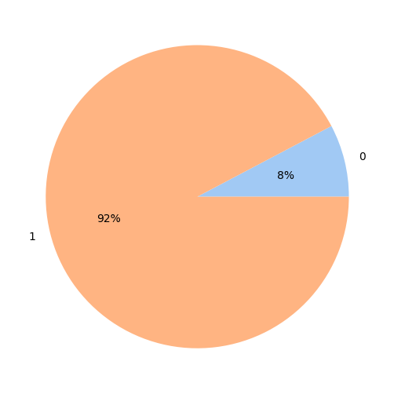
Percentage of non taken orders
92% of the orders were taken by any Courier, 8% were not taken by any Courier.
Taken (1) | Not taken (0)
115860 | 9689

Slide 9
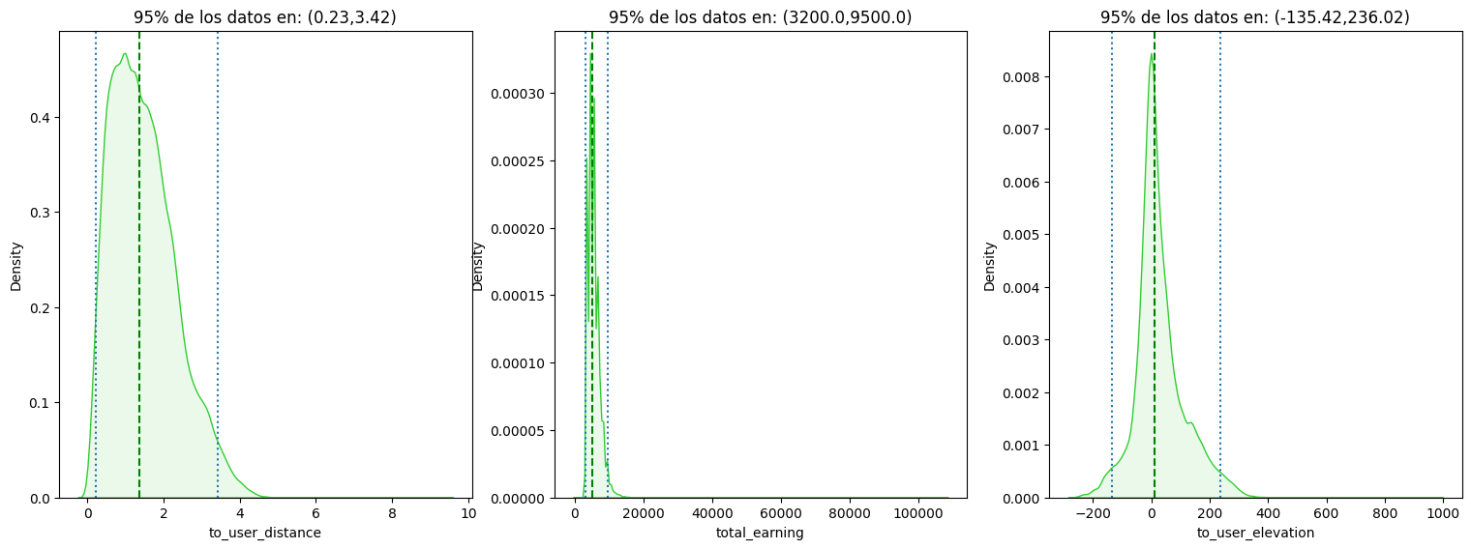
95% of the clients are between 0.23km and 3.42km away from the store.
95% of total earnings of a Courier is between $3200 and $9500
95% of user elevation to the store is between -135.42m and 236.02m

Slide 10
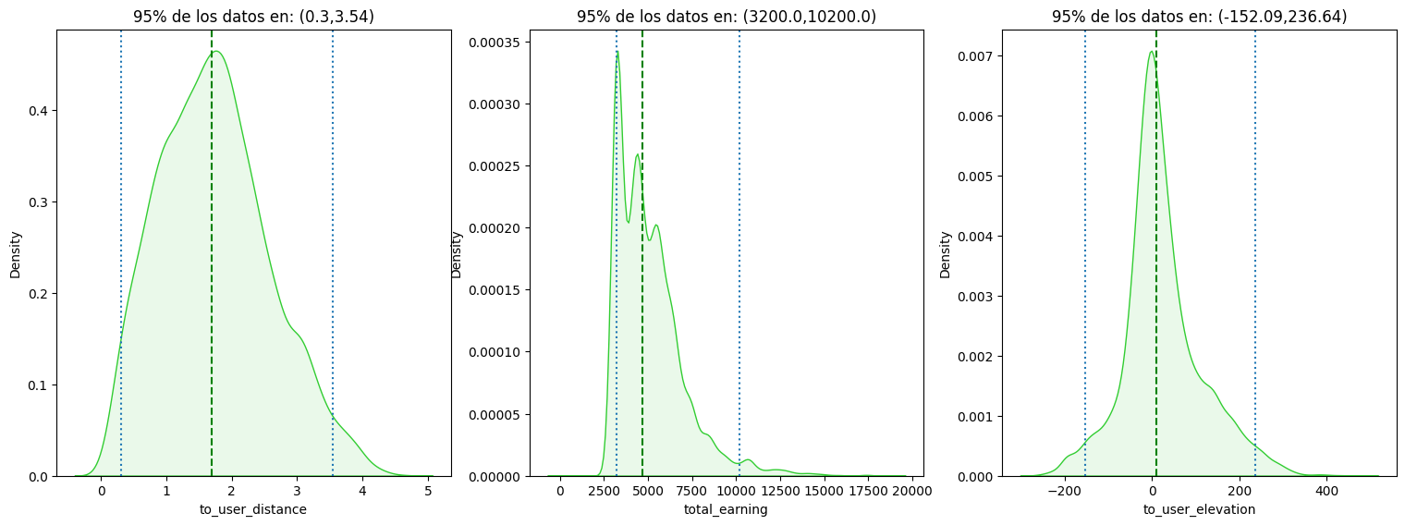
Checking only non taken orders:
95% of the clients are between 0.3km and 3.54km away from the store.
95% of total earnings of a Courier is between $3200 and $10500
95% of user elevation to the store is between -152.09m and 236.64m

Slide 11
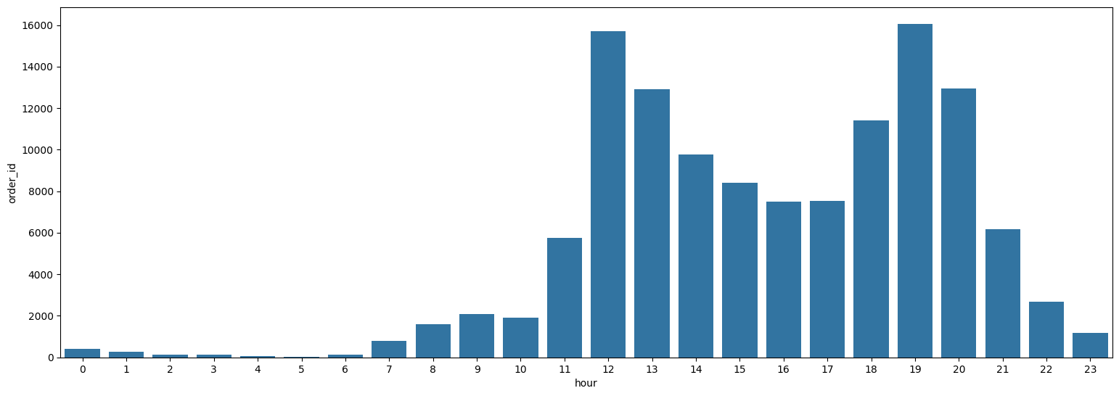
The peak hours in terms of orders created usually matches the lunch time and the dinner time, with steady levels in the afternoon and the early night (around 20 to 21 hours).

Slide 12
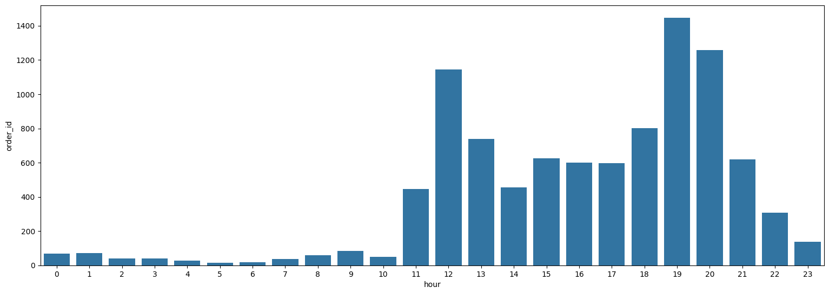
Checking only non taken orders, we have critical peaks at the lunchtime and most of the non taken order are concentrated in the late-afternoon – night hours.

Slide 13
Categorizing the data by hour
Category | Hours
Early Morning | 3 – 6
Morning | 7 – 11
Afternoon | 12 – 15
Evening | 16 – 18
Night | 19 – 22
Midnight | 23 - 2
If we categorize the hour of the day when the order was originally created, we can gain some general insights among taken and non taken orders.

Slide 14
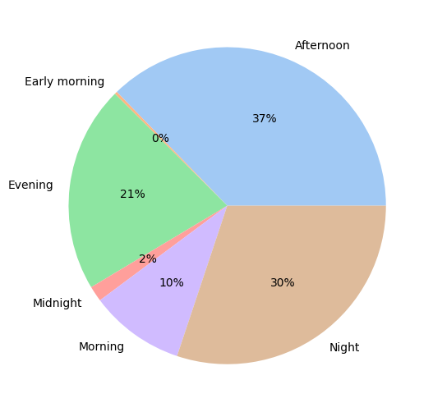
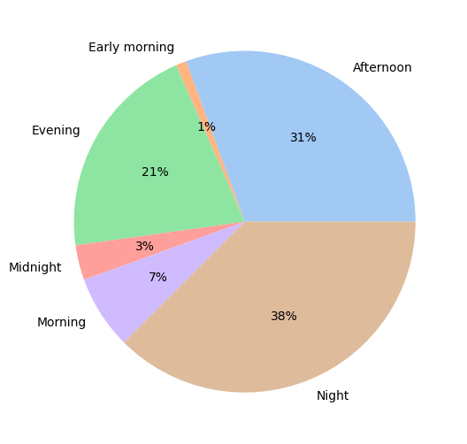
Total orders
Non taken orders
The highest percentage of non taken orders are in the night

Slide 15
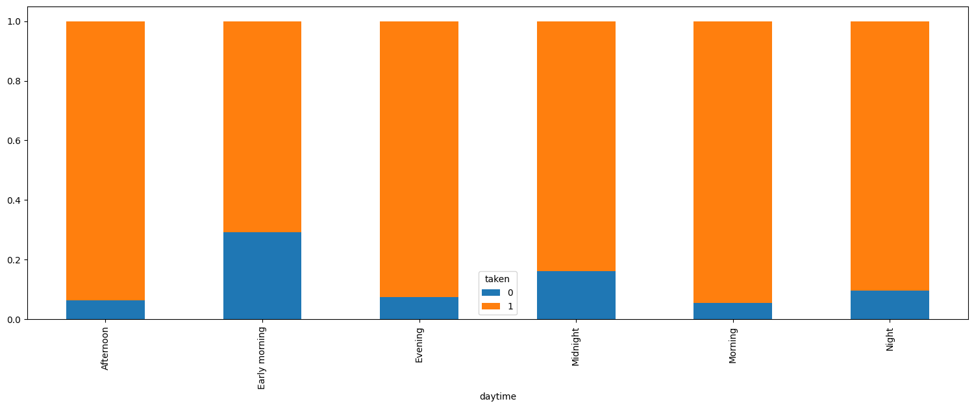
But relatively, in the early morning and in the midnight is more probable that an order may not be accepted by any Courier.

Slide 16
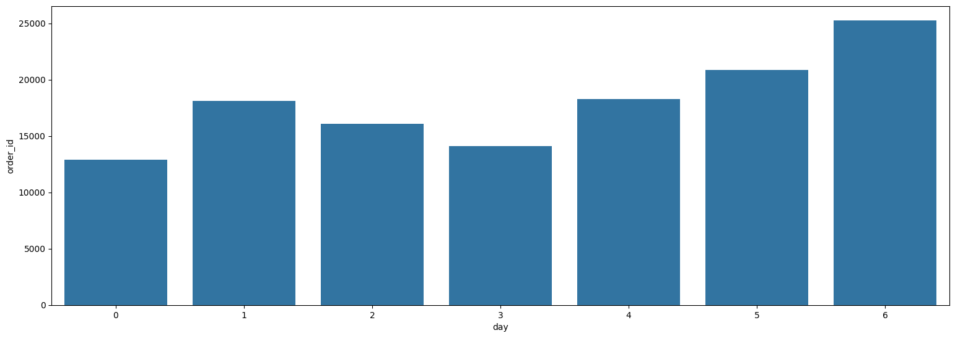
The days that have most orders are on the weekends (Friday, Saturday and Sunday) and the Tuesday.

Slide 17
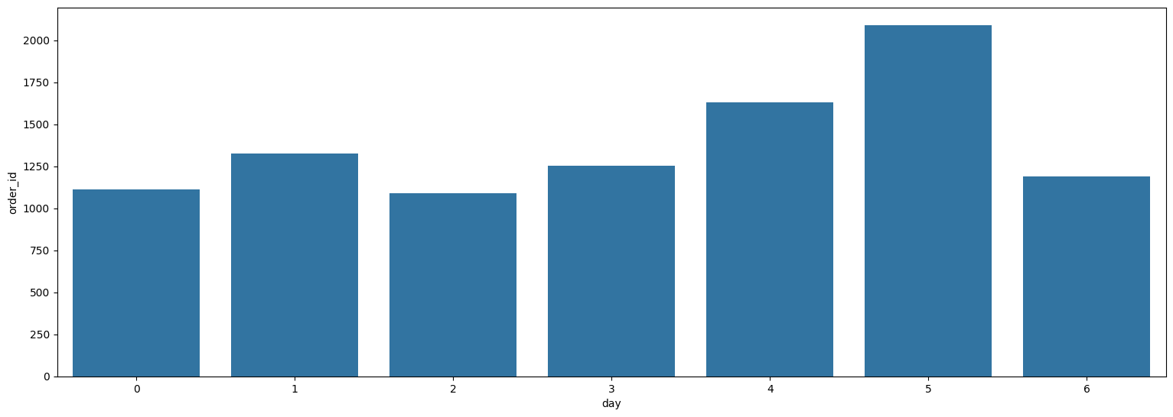
But the days with more non taken orders are the Fridays and Saturdays. The day with less non taken orders is Sunday.

Slide 18

Prior Analysis
03
Possible patterns in the data

Slide 19
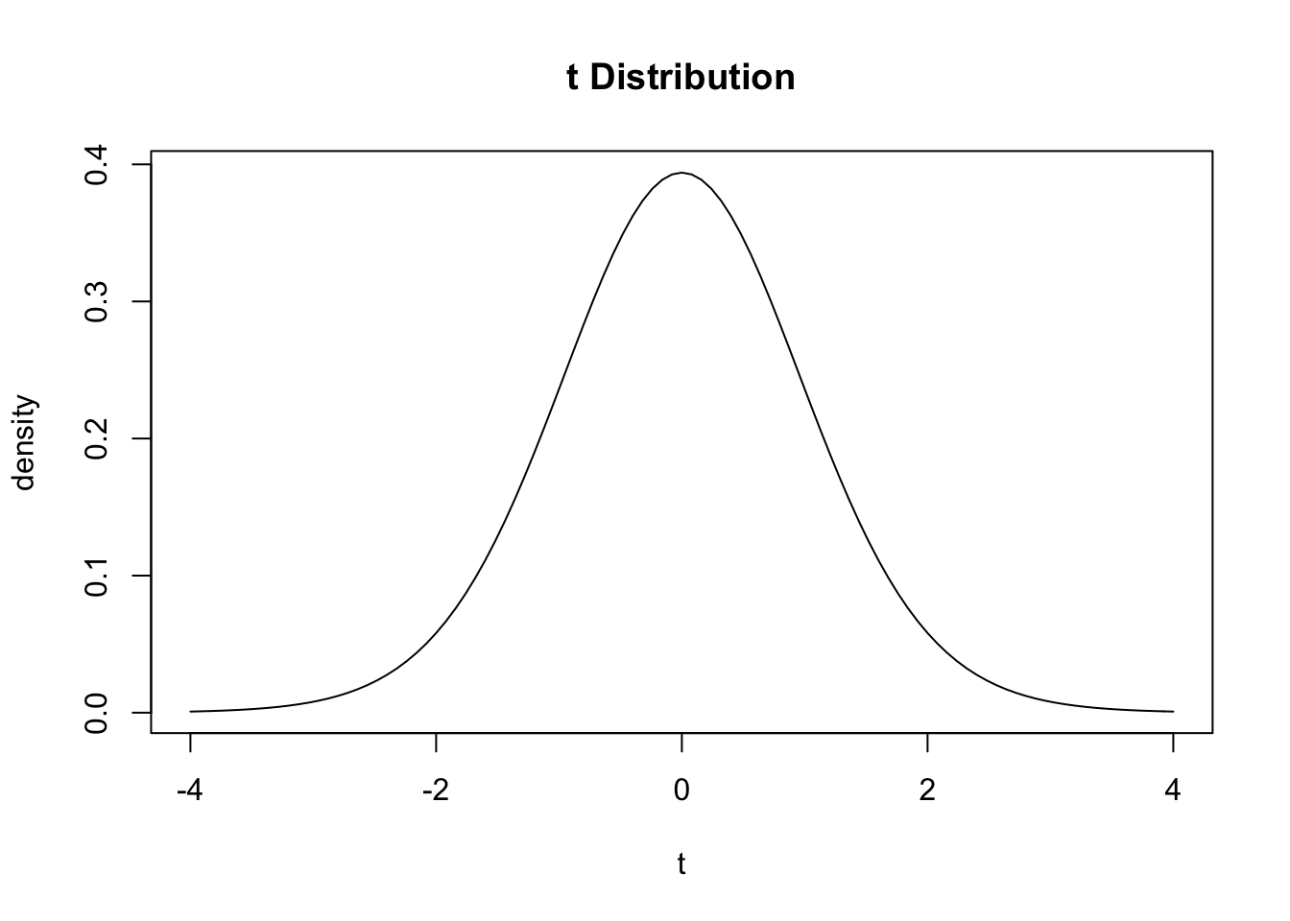
T-test
We test for mean differences with the null hypothesis that the taken orders have lesser values that the non taken orders.
We assume different variances for each group for robustness.

Slide 20



T-test for difference of means
The total earnings is higher in the ‘taken’ group.
P-value = 2.3e-55
The total distance is lower in the ‘taken’ group.
P-value = 1
The difference in altitude is positive and higher in the ‘taken’ group
P-value = 1.1e-5

Slide 21

Experiment
04
How we set the environment

Slide 22




Solving problems
Unbalanced Dataset
One hot encoding
Undersampling for majority class (taken orders)
For considering discrete variables (day, hour)
Normalizing
Cross-Validation
For continuous variables, in order to solve high variance
In order to assure the quality of the experiment

Slide 23

05
Modelling
Techniques and results

Slide 24
Modelling Results
Types of classification models tested: 3 of them ensembles, logistic regression, Naïve Bayes, SVC.
33
Different configurations of parameters, with 3 validation folds.
6
5
Different metrics of classification: accuracy, f1, precision, recall and ROC - AUC
8
Highly relevant variables capable of giving valuable insights

Slide 25
XGBoost
Got the highest score! 0.66 average in the train and test split across all metrics!

Slide 26
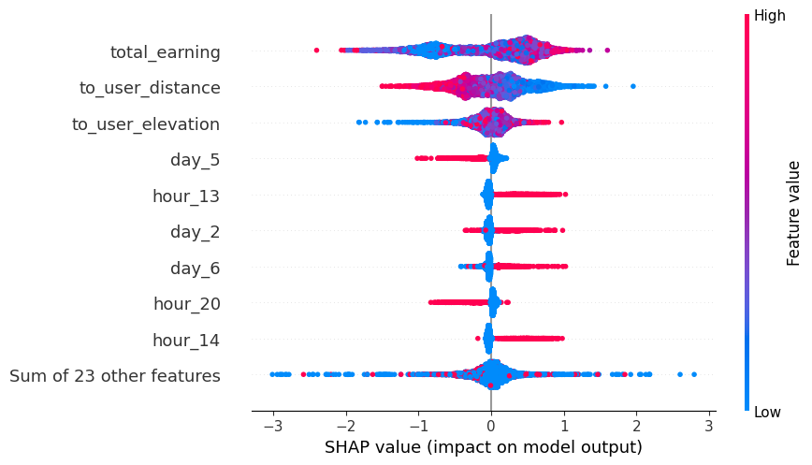
Variable Interpretation
SHAP values strongly suggest that the 20 hour and the Saturday are strong predictors whenever an order is not accepted. Higher total earning and lower user distance are strong predictors of higher acceptance.

Slide 27

06
Recommendations
Final conclusions and remarks

Slide 28





Conclusions
Key Hours
Rates for distance
Happy Weekdays
Lunch hours
Weather checking
Offer higher rates at night to the couriers
Offer higher rates if the distance is higher than 2.8km
Offer incentives to pick more orders on saturdays
Encourage the user to order before peak hours to avoid saturation in the lunch and dinner hour
For an upcoming challenge, take into account the weather information

Slide 29
Thank you!

